Slide 1
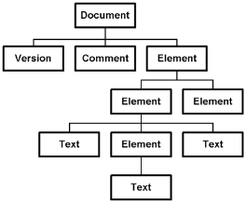

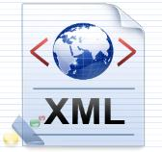




Processing XML in .NET
DOM Parser, Streaming Parser, XPath, LINQ to XML
Svetlin Nakov
Manager Technical Training
www.nakov.com
Telerik Software Academy
http://academy.telerik.com

Slide 2


Table of Contents
Processing XML documents in .NET
Using the DOM Parser
Using the Streaming Parser
Using XPath to Search in XML Documents
Using LINQ-To-XML
XSL Transformation in .NET

Slide 3
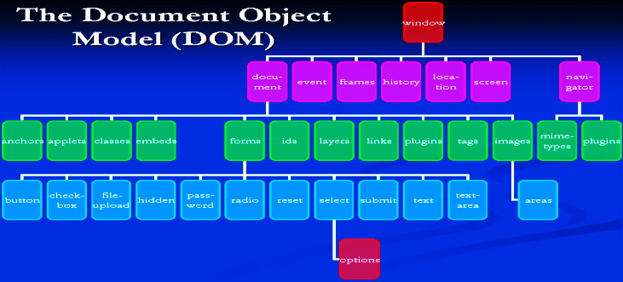
The DOM Parser
Parsing XML Documents as DOM Trees

Slide 4
The DOM Parser
The following XML document is given:
<?xml version="1.0"?>
<library name=".NET Developer's Library">
<book>
<title>Professional C# 4.0 and .NET 4</title>
<author>Christian Nagel</author>
<isbn>978-0-470-50225-9</isbn>
</book>
<book>
<title>Silverlight in Action</title>
<author>Pete Brown</author>
<isbn>978-1-935182-37-5</isbn>
</book>
</library>

Slide 5
The DOM Parser (2)
This document is represented in the in the memory as a DOM tree in the following way:
Header part (prolog)
Root node

Slide 6
The DOM Parser – Example
XmlDocument doc = new XmlDocument();
doc.Load("library.xml");
XmlNode rootNode = doc.DocumentElement;
Console.WriteLine("Root node: {0}", rootNode.Name);
foreach (XmlAttribute atr in rootNode.Attributes)
{
Console.WriteLine("Attribute: {0}={1}",
atr.Name, atr.Value);
}
foreach (XmlNode node in rootNode.ChildNodes)
{
Console.WriteLine("\nBook title = {0}",
node["title"].InnerText);
Console.WriteLine("Book author = {0}",
node["author"].InnerText);
Console.WriteLine("Book isbn = {0}",
node["isbn"].InnerText);
}

Slide 7
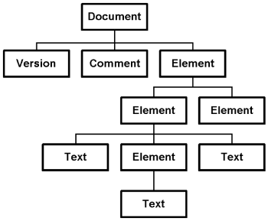
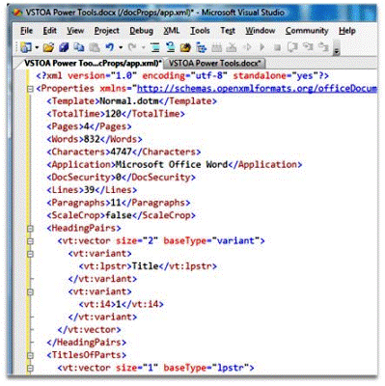

Parsing XML Document with the DOM Parser
Live Demo

Slide 8
Classes to Work with DOM
The DOM parser provides few important classes:
XmlDocument
Represents the DOM tree
Usually contains two elements:
Header part (prolog)
The root element of the XML document
XmlNode
Abstract base class for all nodes in a DOM tree

Slide 9
Classes to Work with DOM (2)
XmlElement
Represents a XML element
XmlAttribute
Represents an attribute of an XML tag (couple name-value)
XmlAttributeCollection
List of XML attributes attached to an element
XmlNodeList
List of XML DOM nodes

Slide 10
The XmlNode Class
The class System.Xml.XmlNode:
Fundamental for the DOM processing
Represents a base node
Its inheritor-classes are:
XmlDocument, XmlElement, XmlAttribute, XmlDeclaration, …
Allows navigation in the DOM tree:
ParentNode – returns the parent node (null for the root)

Slide 11
The XmlNode Class (2)
PreviousSibling / NextSibling – returns the left / right node to the current
FirstChild / LastChild – returns the first / last child of the current node
Item (indexer [] in C#) – returns the child of the current node by its name
Working with the current node:
Name – returns the name of the node (element, attribute …)
Value – gets the node value

Slide 12
The XmlNode Class (3)
Attributes – returns the node attributes as XmlAttributeCollection
InnerXml, OuterXml – returns the part of the XML containing the current node
Respectively with or without the node itself
InnerText – concatenation of the values of the node and its inheritors
NodeType – returns the node type

Slide 13
The XmlNode Class (4)
Changing of the current node:
AppendChild(…) / PrependChild(…)
Inserts new child after / before all other children of the current node
InsertBefore(…) / InsertAfter(…)
Inserts new child before / after given inheritor
RemoveChild(…) / ReplaceChild(…)
Removes / replaces given child

Slide 14

The XmlNode Class (5)
RemoveAll() – deletes all children of the current node (element, attribute …)
Value, InnerText, InnerXml – changes the value / text / XML text of the node

Slide 15
The XmlDocument Class
The System.Xml.XmlDocument:
Contains XML document represented as DOM tree
Allows loading and saving XML document (from files, streams or strings)
Load(…), LoadXml(…), Save(…)
Important properties, methods and events:
DocumentElement – returns the root element

Slide 16
The XmlDocument Class (2)
Important properties, methods and events:
PreserveWhitespace – indicates if the white space to be kept during save or load
CreateElement(…), CreateAttribute(…), CreateTextNode(…) – creates new XML element, attribute or value for the element
NodeChanged, NodeInserted, NodeRemoved – events for tracking the changes in the document

Slide 17





Modifying XML Document Using the DOM Parser
Live Demo

Slide 18



The Streaming Parser
Using XmlReader and XmlWriter

Slide 19
SAX and StAX Parsers
SAX-style parsers are 'push' parsers
'Push' data to the application
Event handlers for processing tags, attributes, data, whitespace, etc.
StAX-like parsers are 'pull' parsers
'Pull' the information from the parser as needed
The application moves the document's cursor forward (like reading a stream)
XmlReader is StAX-style (streaming) parser

Slide 20
SAX and StAX Parsers and XmlReader
In .NET stream processing of XML document is done with the XmlReader class
XmlReader is abstract class, which:
Provides read-only access to the XML data
Works like a stream, but reads XML documents
Works in forward-only mode
Read at each step data (tags, attributes, text) can be extracted and analyzed

Slide 21
The XmlReader Class
The XmlReader class – most important methods and properties:
Read() – reads next node from the XML document or returns false if no such node
NodeType – returns the type of the read node
Name – returns the name of the read node (name of the last read element, attribute, …)
HasValue – returns true if the node has value
Value – returns the node value

Slide 22
The XmlReader Class (2)
ReadElementString() – reads the value (the text) from the last read element
AttributeCount, GetAttribute(…) – extract the attributes of the current element
XmlReader is an abstract class
Instantiated with the static method Create(…)
Implements IDisposable
using (XmlReader reader = XmlReader.Create("items.xml"))
{
while (reader.Read()) { … }
}

Slide 23


Working with XmlReader
Live Demo

Slide 24
Working with XmlWriter
The class XmlWriter creates XML documents
Works as a stream, but writes tags and data into XML documents
Most important methods:
WriteStartDocument() – adds the prolog part in the beginning of the document (<?xml …)
WriteStartElement(…) – adds opening tag
WriteEndElement() – closes the last tag
WriteElementString(…) – adds an element by defined name and text value

Slide 25
Working with XmlWriter (2)
WriteAttributeString(…) – adds an attribute to the current element
WriteEndDocument() – closes all tags and flushes the internal buffer (by calling Flush())
XmlWriter is an abstract class
Instantiated by that static method Create(…)
Implements IDisposable
using (var writer = new XmlTextWriter ("items.xml"))
{
// Write nodes here
}

Slide 26


Working with XmlWriter
Live Demo

Slide 27

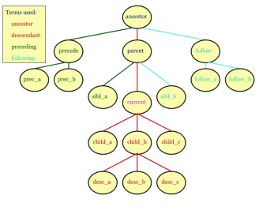
Using XPath

Slide 28
Using XPath in .NET
XPath functionality is implemented in the System.Xml.XPath namespace
XPath can be used directly from the class XmlNode (and all its inheritors) :
SelectNodes(string xPathExpression)
Returns list of all nodes matched by the specified XPath expression
SelectSingleNode(string xPathExpression)
Returns the first node matched by the specified XPath expression

Slide 29

XPath and XmlNode – Example
Suppose we want to find the beer's nodes
<?xml version="1.0" encoding="windows-1251"?>
<items>
<item type="beer">
<name>Zagorka</name>
<price>0.75</price>
</item>
<item type="food">
<name>sausages</name>
<price>0.48</price>
</item>
<item type="beer">
<name>Kamenitza</name>
<price>0.65</price>
</item>
</items>

Slide 30
XPath and XmlNode – Example (2)
static void Main()
{
XmlDocument xmlDoc = new XmlDocument();
xmlDoc.Load("../../items.xml");
string xPathQuery = "/items/item[@type='beer']";
XmlNodeList beersList =
xmlDoc.SelectNodes(xPathQuery);
foreach (XmlNode beerNode in beersList)
{
string beerName =
beerNode.SelectSingleNode("name");
Console.WriteLine(beerName.InnerText);
}
}

Slide 31



Searching with XPath in XML Documents
XPath
Live Demo

Slide 32

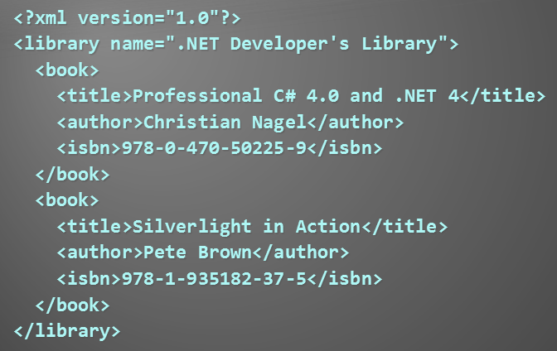
LINQ to XML
LINQ
XML

Slide 33
LINQ to XML
LINQ to XML
Use the power of LINQ to process XML data
Easily read, write, modify, and search in XML documents
Elements and attributes are no longer built-in the context of their parents
LINQ to XML classes:
XDocument – represents a LINQ-enabled XML document (containing prolog, root element, …)

Slide 34
LINQ to XML Classes
LINQ to XML classes:
XElement – represents an XML element
The most fundamental class in LINQ to XML
Important methods: Parse, Save, RemoveAtributes, SetElementValue, SetAtributeValue, WriteTo
XAttribute – name/ value attribute pair
XName – tag name + optional namespace – {namespace}localname
XNamespace – XML namespace

Slide 35
LINQ to XML – How Easy It Is!
<books>
<book>
<author>Don Box</author>
<title>Essential .NET</title>
</book>
</book>
Need to create this XML fragment?
XElement books =
new XElement("books",
new XElement("book",
new XElement("author", "Don Box"),
new XElement("title", "ASP.NET")
)
);

Slide 36


Creating Document with LINQ To XML
LINQ
Live Demo

Slide 37
LINQ to XML and Namespaces
Elements in LINQ to XML have fully expanded names (namespace + name)
Easy to manipulate the elements in different namespaces
XNamespace ns = "http://linqinaction.net";
XNamespace anotherNS = "http://publishers.org";
XElement book = new XElement(ns + "book",
new XElement(ns + "title", "LINQ in Action"),
new XElement(ns + "author", "Manning"),
new XElement(ns + "author", "Steve Eichert"),
new XElement(ns + "author", "Jim Wooley"),
new XElement(anotherNS + "publisher", "Manning")
);

Slide 38



LINQ to XML and Namespaces
Live Demo

Slide 39
LINQ to XML – Searching with LINQ
Searching in XML with LINQ is as easy as searching within an array
XDocument xmlDoc = XDocument.Load("../../books.xml");
var books =
from book in xmlDoc.Descendants("book")
where book.Element("title").Value.Contains("4.0")
select new {
Title = book.Element("title").Value,
Author = book.Element("author").Value };
foreach (var book in books)
{
Console.WriteLine(book);
}

Slide 40




Searching in XML with LINQ Queries
Live Demo
XML
LINQ

Slide 41

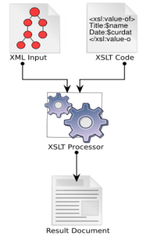

XSL Transformations
XSL

Slide 42
XSL Transformations
XSL transformations (XSLT)
Convert a XML document to another XML document with different structure
Can convert XML to any text format
Can be used to transform XML documents to XHTML
XSLT depends on XPath
For matching sections from the input document and replacing them with other text

Slide 43
Performing XSLT in .NET
.NET has built-in XSLT engine
System.Xml.Xsl.XslCompiledTransform
Methods:
Load(…)
Loads XSL shylesheet for transforming XML docs
Transform(…)
Performs transformation of given XML
Output is written to a XML file, stream or XmlWriter

Slide 44
XSL Transformation – Example
Transforming XML document by given XSL stylesheet:
using System;
using System.Xml.Xsl;
class XSLTransformDemo
{
static void Main()
{
XslCompiledTransform xslt =
new XslCompiledTransform();
xslt.Load("catalog.xsl");
xslt.Transform("catalog.xml", "catalog.html");
}
}

Slide 45
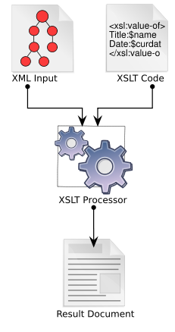

Transforming XML by XSL Stylesheet

Slide 46
Processing XML in .NET
http://academy.telerik.com/student-courses/software-technologies/databases/

Slide 47
Exercises
Create a XML file representing catalogue. The catalogue should contain albums of different artists. For each album you should define: name, artist, year, producer, price and a list of songs. Each song should be described by title and duration.
Write program that extracts all different artists which are found in the catalog.xml. For each author you should print the number of albums in the catalogue. Use the DOM parser and a hash-table.
Implement the previous using XPath.
Using the DOM parser write a program to delete from catalog.xml all albums having price > 20.

Slide 48
Exercises (2)
Write a program, which using XmlReader extracts all song titles from catalog.xml.
Rewrite the same using XDocument and LINQ query.
In a text file we are given the name, address and phone number of given person (each at a single line). Write a program, which creates new XML document, which contains these data in structured XML format.
Write a program, which (using XmlReader and XmlWriter) reads the file catalog.xml and creates the file album.xml, in which stores in appropriate way the names of all albums and their authors.

Slide 49
Exercises (3)
Write a program to traverse given directory and write to a XML file its contents together with all subdirectories and files. Use tags <file> and <dir> with appropriate attributes. For the generation of the XML document use the class XmlWriter.
Rewrite the last exercises using XDocument, XElement and XAttribute.
Write a program, which extract from the file catalog.xml the prices for all albums, published 5 years ago or earlier. Use XPath query.
Rewrite the previous using LINQ query.

Slide 50
Exercises (4)
Create an XSL stylesheet, which transforms the file catalog.xml into HTML document, formatted for viewing in a standard Web-browser.
Write a C# program to apply the XSLT stylesheet transformation on the file catalog.xml using the class XslTransform.
* Read some tutorial about the XQuery language. Implement the XML to HTML transformation with XQuery (instead of XSLT). Download some open source XQuery library for .NET and execute the XQuery to transform the catalog.xml to HTML.

Slide 51
Exercises (5)
Using Visual Studio generate an XSD schema for the file catalog.xml. Write a C# program that takes an XML file and an XSD file (schema) and validates the XML file against the schema. Test it with valid XML catalogs and invalid XML catalogs.

Slide 52

Promotion
Promotion – the beer became free (hurrah !!!)

Slide 53




Free Trainings @ Telerik Academy
"Web Design with HTML 5, CSS 3 and JavaScript" course @ Telerik Academy
html5course.telerik.com
Telerik Software Academy
academy.telerik.com
Telerik Academy @ Facebook
facebook.com/TelerikAcademy
Telerik Software Academy Forums
forums.academy.telerik.com

